Slide 1
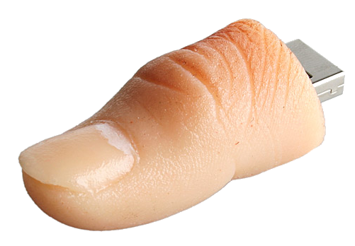
Exercise 2: Thumbnails

Slide 2
Exercise 2: Thumbnails
https://github.com/topherCantrell/class-HTMLCSS/tree/master/Exercise2
Rework the Mushroom web site to use thumbnails.
Use your own files from the previous exercise or download the solution:
https://github.com/topherCantrell/class-HTMLCSS/tree/master/Exercise1/solution
Create a directory structure for the HTML and images.
Resize the images to make thumbnails.
Each journal entry should be its own HTML page.

Slide 3
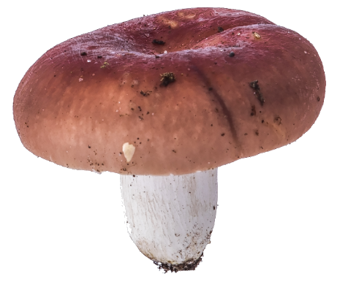
Exercise 2: Thumbnails
The Fun Guy (get it?)
Pictures of awesome …
January 2015
March 2015
June 2015
Title
Description
Placeholder (no image for journal entry)
Months
Thumbnails

